Slide 1
Optical communications and data networks (EENGM2001) Week13_Lecture005_ASync_Fibre
Siddarth K Joshi

Slide 2
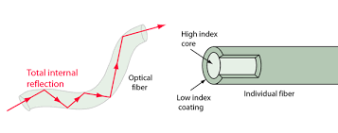
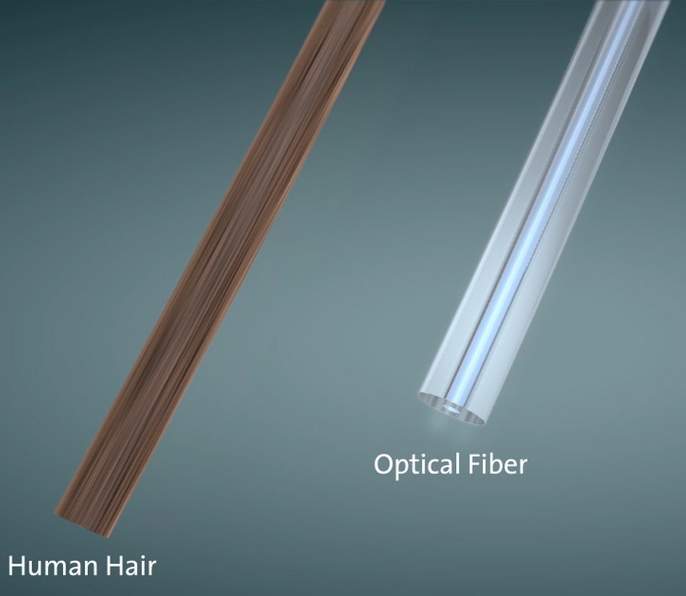
Optical Fibre
Works by total internal reflection
Backbone of all internet traffic
High refractive index core and low index cladding
Can be singlemode or multimode

Slide 3
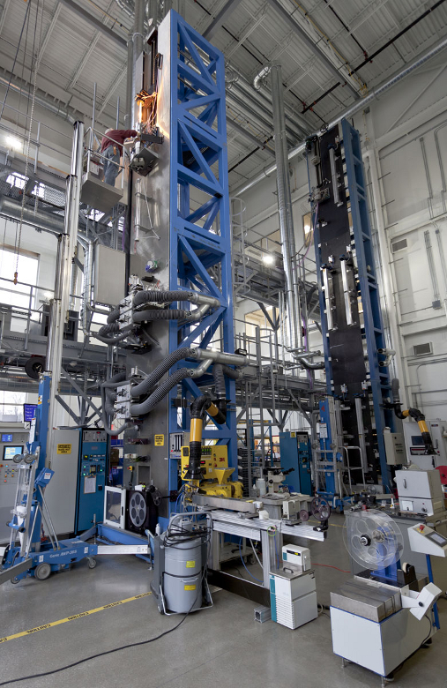

Optical Fibre
Made from types of Glass. (Typically Silica)
A preform is heated and stretched to create the fibre.
It is then coated with protective layers as needed.
Nice video if you are interested
https://www.youtube.com/watch?v=VRe5b6lPEis

Slide 4
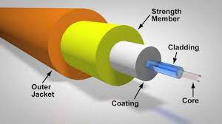
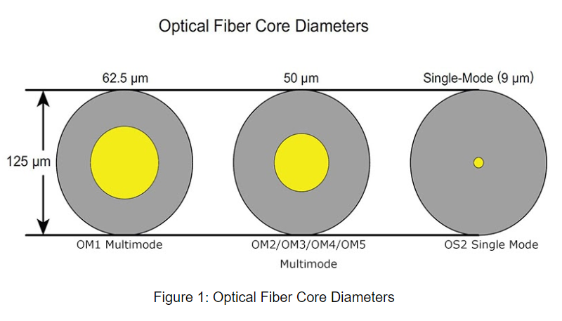
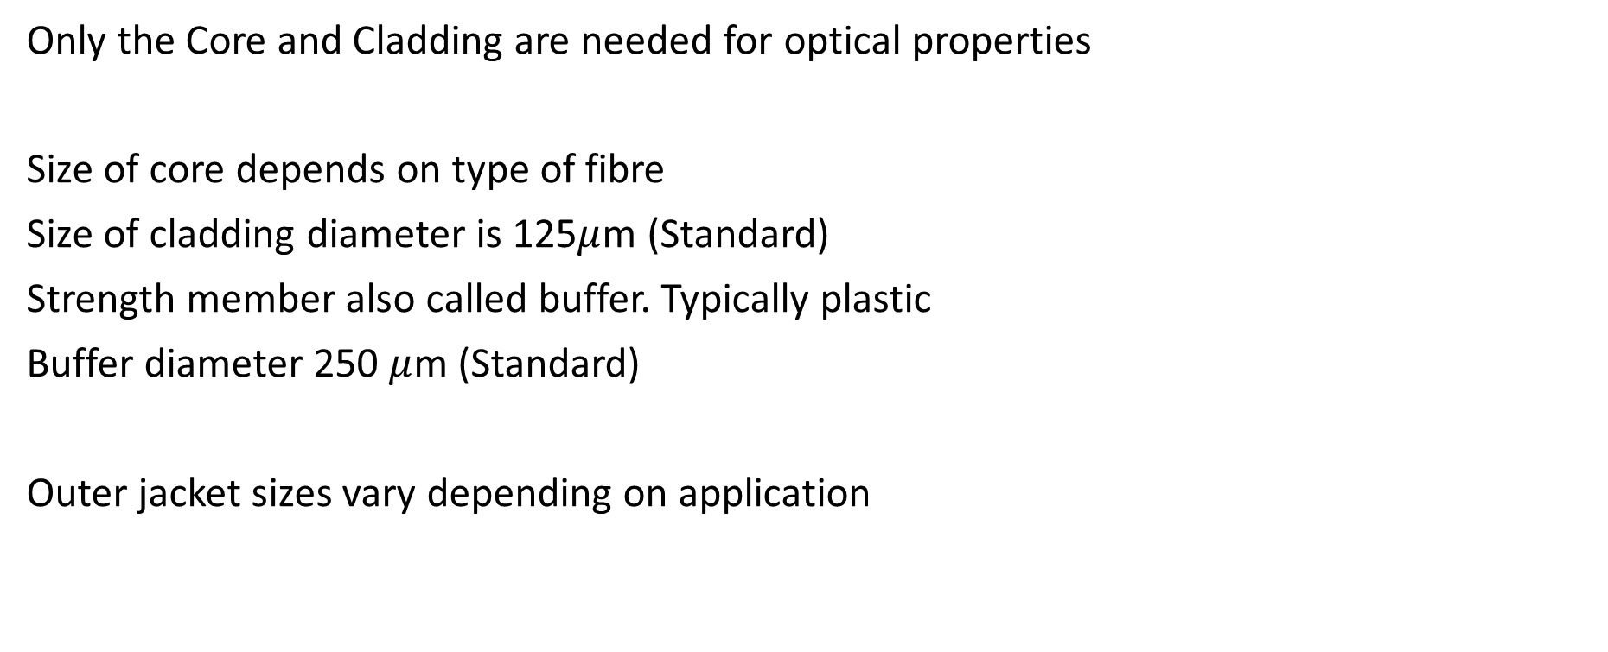
Optical Fibre
Only the Core and Cladding are needed for optical properties
Size of core depends on type of fibre
Size of cladding diameter is 125$μ$m (Standard)
Strength member also called buffer. Typically plastic
Buffer diameter 250 $μ$m (Standard)
Outer jacket sizes vary depending on application

Slide 5
Types of fibre
Types of Optical Fibre
Based on refractive index
Wavelength
Mode
Special purpose
Form factor

Slide 6
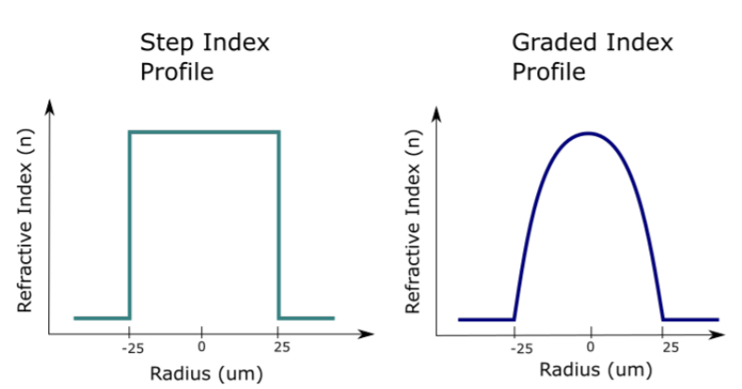
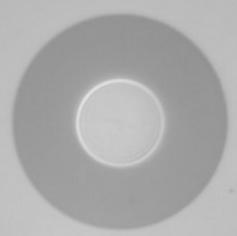
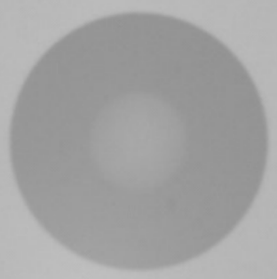
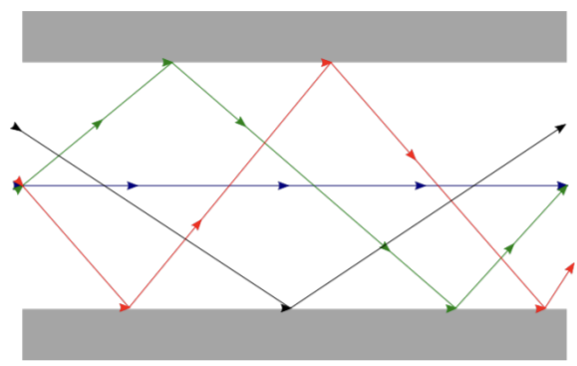
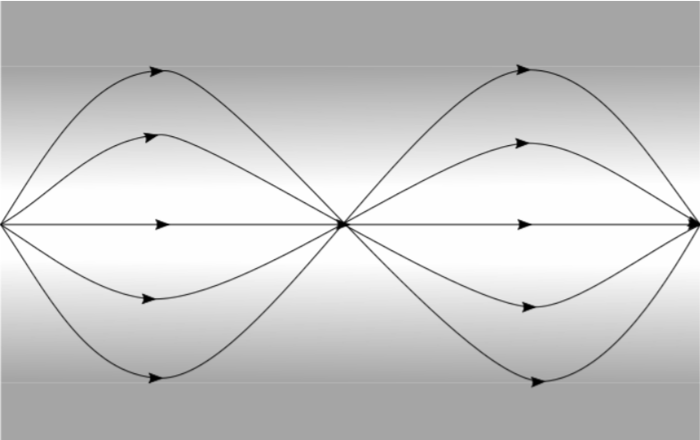
Types of fibre
Step index | Graded index
For SM and MM fibres | For MM fibres
Multiple paths for different modes. Different modes arrive at different times. (Modal dispersion) | All paths take same time because of faster speeds at lower refractive indices
Cheap | Costly
Higher loss (MM only) | Lower loss (MM only)
Short distance MM links | Long Distance MM links

Slide 7
Problem
A hypothetical approx 5700km under sea fibre link connects Bristol to New York. If light were travelling in vacuum it would take 19ms to travel that distance. If the refractive index of the fibre is 1.5 what is the time the optical signal takes to travel through the fibre?
Choose your answer in the quiz.
Notes:
28.5, 12.67, 25, 19

Slide 8
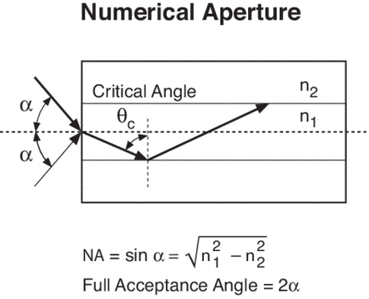


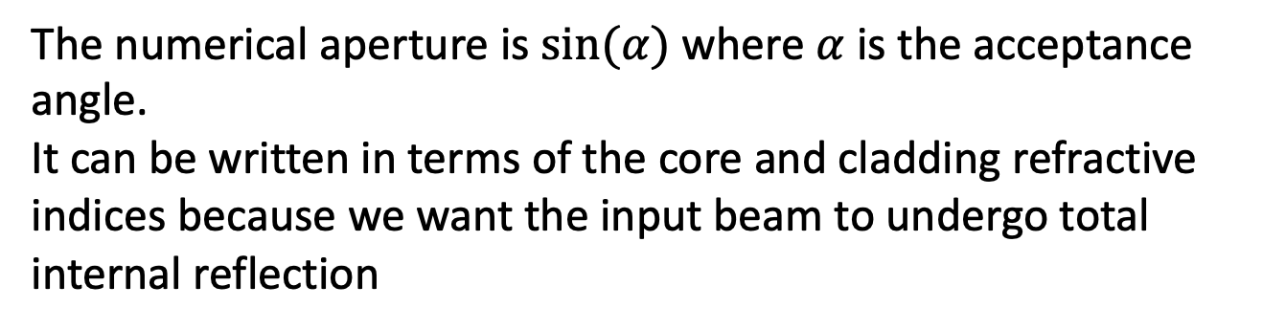
Types of fibre
You can design a fibre to be single mode at any wavelength where the material is transparent.
Core radius r_{core} = $\frac{2.405λ}{2πN.A.}$ Where N.A. is the desired numerical aperture.
The numerical aperture is $sin(α)$ where $α$ is the acceptance angle.
It can be written in terms of the core and cladding refractive indices because we want the input beam to undergo total internal reflection
r_{core} = $\frac{2.405λ}{{2π√(n}_{1}^{2}−n_{2}^{2})}$

Slide 9

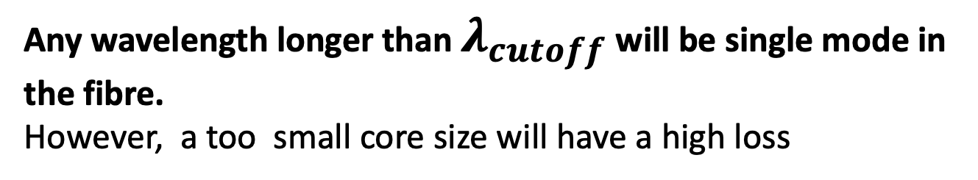
Types of fibre
Given a fibre core diameter, and core & cladding refractive indices it is possible to find the shortest wavelength at which the fibre is single mode.
${λ_{cutoff}= 2πr}_{core}{√(n}_{1}^{2}−n_{2}^{2}$)/2.405
Any wavelength longer than $λ_{cutoff}$ will be single mode in the fibre.
However, a too small core size will have a high loss

Slide 10
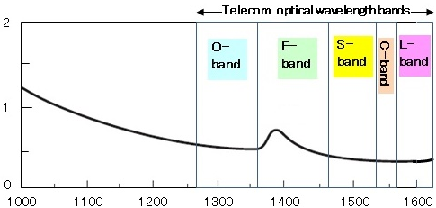
Types of fibre
Wavelength chosen to minimise loss
Attenuation (dB/km)
Attenuation (dB/km)
Wavelength (μm)
Original O-band: 1260—1360 nm
Extended E-band: 1360—1460 nm
Short S-band: 1460—1530 nm
Conventional C-band: 1530—1565 nm
Long L-band: 1565—1625 nm
Ultra Long U-band: 1625—1675 nm
Wavelength (μm)
Short wavelength loss mostly due to Rayleigh scattering
OH⁻ absorption peaks
Long wavelength absorption mostly due to vibrational transitions
In fact, it is the properties of fibres which dictate the choice of telecommunications wavelengths

Slide 11
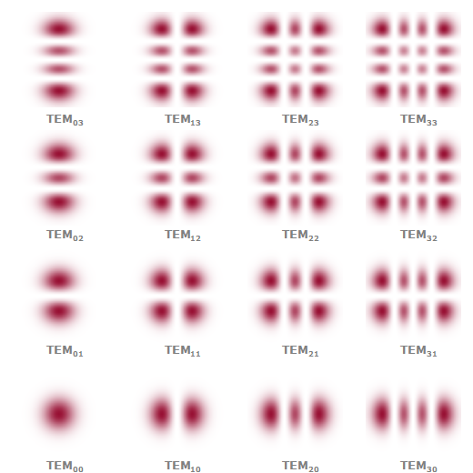
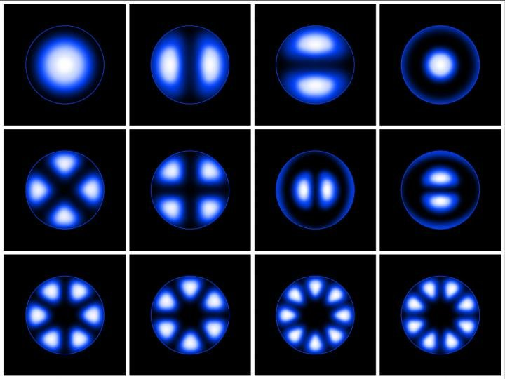
Spatial Modes
The gaussian beam is the simplest spatial mode
The fibre is a waveguide and can support several modes
Fibres that support only a single spatial mode at a given wavelength are single mode at that wavelength
Single and multimode fibres refer to the number of spatial modes supported

Slide 12
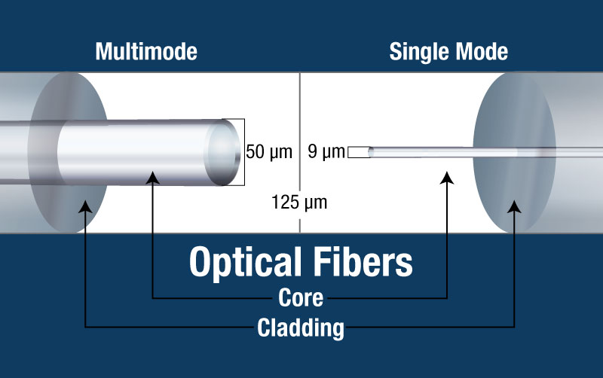
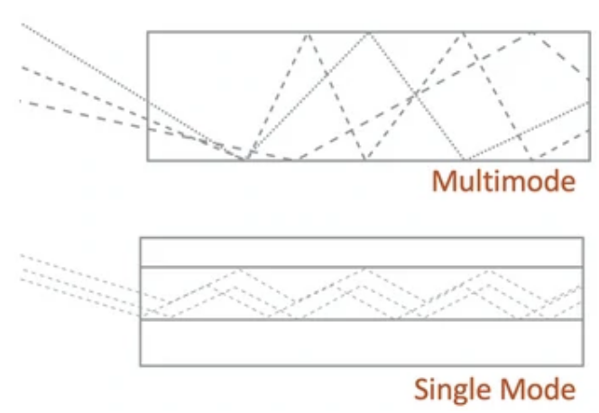
Types of fibre
Single Mode (SM) | Multi Mode (MM)
Same Cladding diameter | 125 microns (standard)
Small core | Large core
Cheap fibre | Slightly more expensive fibre
Expensive equipment | Cheap Equipment
Long haul application | Short distances only (<0.5km)
Best beam quality | LED like spatial mode quality
Complex input coupling | Easy low loss input coupling
Why is the SM equipment more expensive than MM?
Can you use what you have learnt in this lecture and about gaussian optics to figure it out?

Slide 13
Types of fibre
Some special purpose fibres are used:
Polarisation Maintaining Fibre
Dispersion compensation Fibre
We will learn more about these types of fibre after we study the errors induced in transmission media

Slide 14
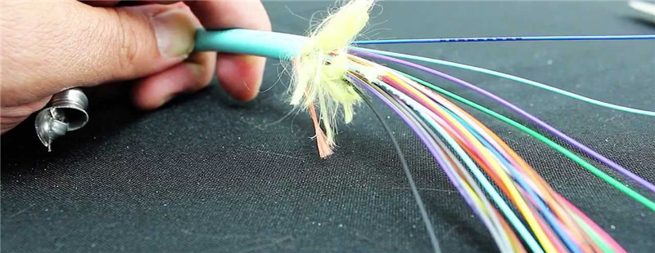
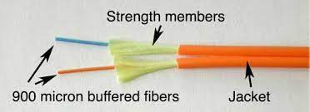
Types of fibre by form factor
900 micron jacket: Typically used in protected environments (E.g. within instruments) or in fibre bundles.
Tight buffer: The plastic coating of the jacket and buffer is moulded onto the cladding. Better for long term/deployed fibres
Loose jacket: The fibre can slide through the protective jacket. Easy to make repairs or splices.
3mm Jacket: Normal use. Has Kevlar strength fibres

Slide 15
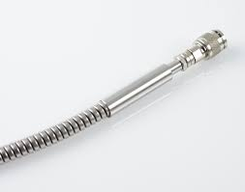
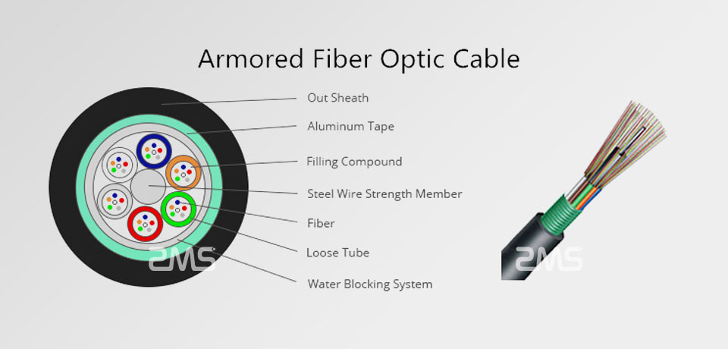
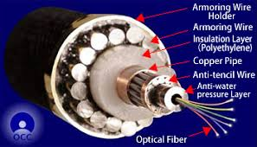
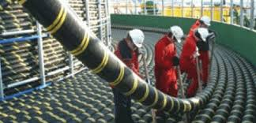
Types of fibre by form factor
Armoured fibre: Metal outer jacket, Kevlar fibres. Outdoor/rugged use.
Deployed fibre
Under sea fibre

Slide 16
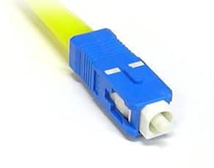
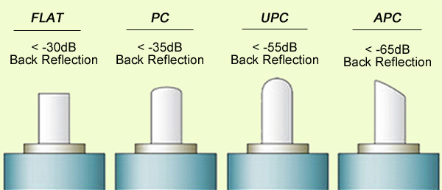
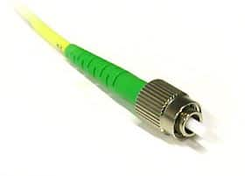
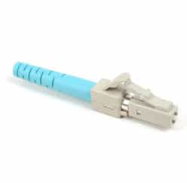
Types of fibre connectors
Standard Connector SC
(OLD)
Clip on and off (easy)
Ferrule Core FC
Screw in (Stable)
Positioning Notch
Lucent Connector LC
Aka little connector
Most popular standard.

